Slide 1

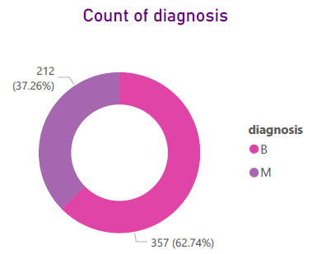
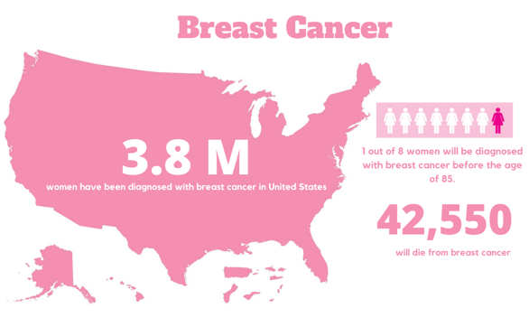
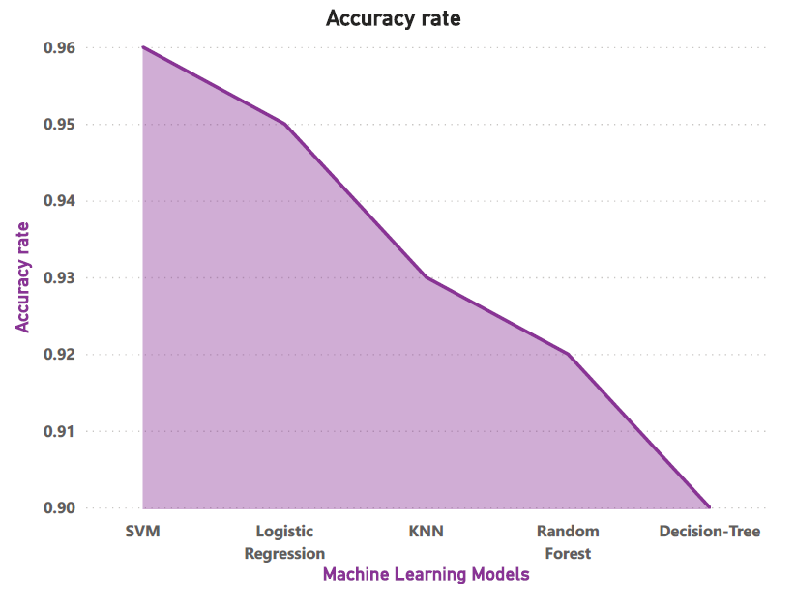
BREAST CANCER DIAGNOSIS AND PREDICTION BY MACHINE LEARNING
Aashiya Aryal, Anuj Ursal, Rosy Shrestha, Yashwant Raut
Abstract
Breast cancer is the most common type of cancer in women worldwide, and it has the second-highest fatality rate.
Machine learning could be of great help to detect if the cancer is benign or malignant using measures of area, smoothness, texture, etc., from a digitized image of cell nuclei.
In this research, we applied four machine learning algorithms such as K-nearest neighbors, Random Forest, Logistic Regression, and Support Vector Machine (SVM) in the Breast Cancer dataset.
After getting the results, a performance evaluation and comparison is done.
Methodology
Data Acquisition and Analysis: The dataset is obtained from Kaggle.
Pre-processing and Visualization: After analysis, data cleaning, selecting attributes, and features extraction is performed.
Build Model: Modelling is done using Logistic Regression, Random Forest, SVM, and KNN, with fit performance measured using metrics like Accuracy, Precision, and Recall.
Result: Based on the performance and evaluation metrics, the best model is selected.
Metrics
 | Precision | Recall | F1 score
Logistic Regression | 0.96 | 0.96 | 0.95
Random Forest | 0.92 | 0.91 | 0.92
KNN | 0.94 | 0.92 | 0.93
SVM | 0.96 | 0.96 | 0.96
Conclusion
On the Wisconsin Breast Cancer dataset, we applied four machine learning algorithms: logistic regression, random forest, SVM and KNN to illustrate the reliable results obtained precisely and find the higher accuracy.
Support Vector Machine achieved a higher efficiency of 97.2%, Precision of 97.5% with an AUC of 96.6%, and surpass all algorithms used
Support Vector Machine has demonstrated most of its efficiency in the prediction and diagnosis of Breast Cancer in terms of accuracy and precision.
The study is limited to the WBCD dataset obtained from Kaggle. It is necessary to reflect and apply the same algorithms and methods to other databases to confirm the results obtained with higher accuracy on a larger dataset.
Introduction
Breast cancer is the most diagnosed cancer after lung cancer in women worldwide.
The major signs of breast cancer are lumps, breast shape changes, skin peeling, and redness. The disease accounts for 1 in 3 new female cancers annually.
About 255,000 and 2,300 are diagnosed in women and men respectively which reinforces the need to invest in preventing cancer and fighting against it.
The purpose of this research is to predict and diagnose breast cancer to find out the most details using machine-learning algorithms.
Breast Cancer Wisconsin Diagnostic Dataset has 569 instances (Benign: 357, Malignant: 212), two classes (62.74 % benign, 37.26 % malignant), and 11 integer-valued attributes (-Id -Diagnosis -Radius - Texture -Area -Perimeter -Smoothness -Compactness -Concavity -Concave points -Symmetry -Fractal dimension). Null values and unnecessary columns were removed.
Data Analysis
The objective of the research is to determine whether a breast cancer is benign or malignant using information extracted from a digitized image of the fine-needle aspiration test (FNA) of a breast mass.
Breast Cancer Wisconsin Diagnostic dataset from University of Wisconsin Hospitals Madison Breast Cancer Database was used in this research.
Given the findings of a breast fine-needle aspiration (FNA) test, we create a model that can categorize a breast cancer tumor using two types of training classification:
1= Malignant (Cancer) - Present
0= Benign (non-cancerous) -Not present
Feature Selection was performed by identifying multicollinearity between the attributes and one feature from them was selected.
Research Question
Whether the tumor cell is Malignant or Benign
Evaluation Metrics and Result
The confusion matrix's accuracy, precision, recall, and F1-score are used to evaluate the classification model.
Business Implication
Using machine learning to detect cancer can help to reduce the dependence on the pathologist which is more useful in regions where pathologists are not available.
The severity of the disease can be reduced if detected and diagnosed early with the help of machine learning technique.
References
https://www.sciencedirect.com/science/article/pii/S1877050921014629
https://www.kaggle.com/code/priyanka841/breast-cancer-diagnostics-prediction/notebook?scriptVersionId=32115512
https://www.breastcancer.org/facts-statistics
https://www.cancer.org/cancer/breast-cancer/about/how-common-is-breast-cancer.html
https://archive.ics.uci.edu/ml/datasets/Breast+Cancer+Wisconsin+%28Diagnostic%29

